Slide 1
Matlab程式設計_5_04
助教:金郁善

Slide 2
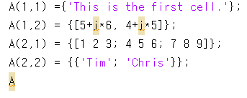
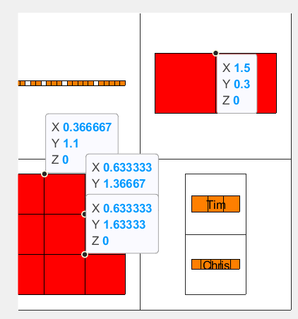
Cell array

Slide 3

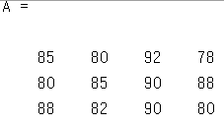
Structure
cat(dim,structureField)
A=cat(1,student.scores)

Slide 4


Average
Get the second quiz score of the third student:

Slide 5
Change values of the structure
Change the first quiz score of the second student

Slide 6


Get name

Slide 7
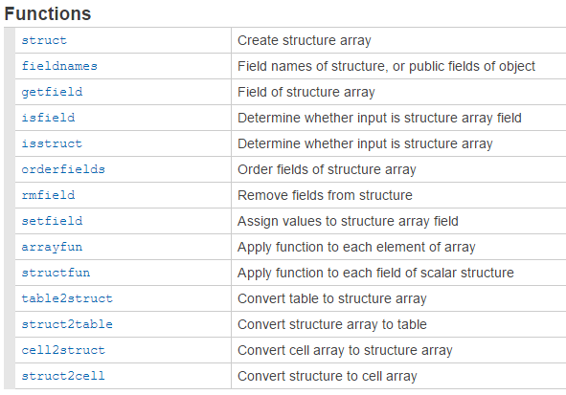

Slide 8


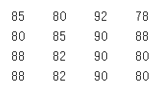
Add new field

Slide 9
Read Excel file with MATLAB
table2struct(readtable(‘test_score1.xls’))
Export data from MATLAB to excel
writetable(struct2table(yourstructure), ‘text_score2.xlsx’)

Slide 10
HOMEWORK

Slide 11
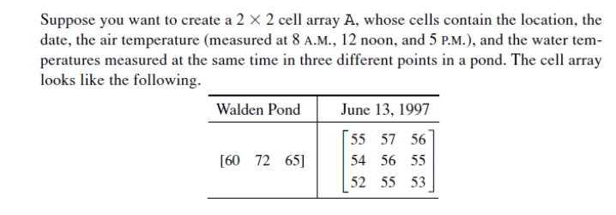

Slide 12
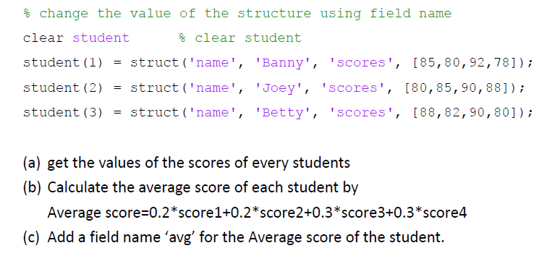

Slide 13
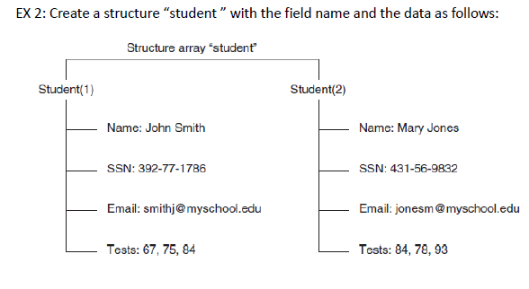

Slide 14
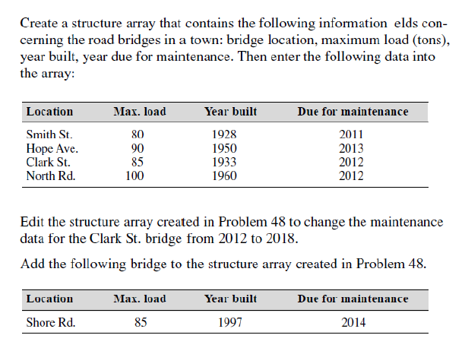

Slide 15
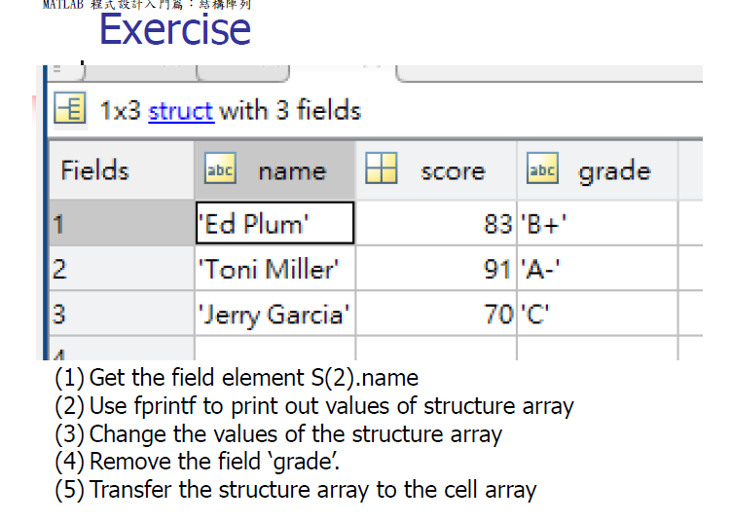

Slide 16
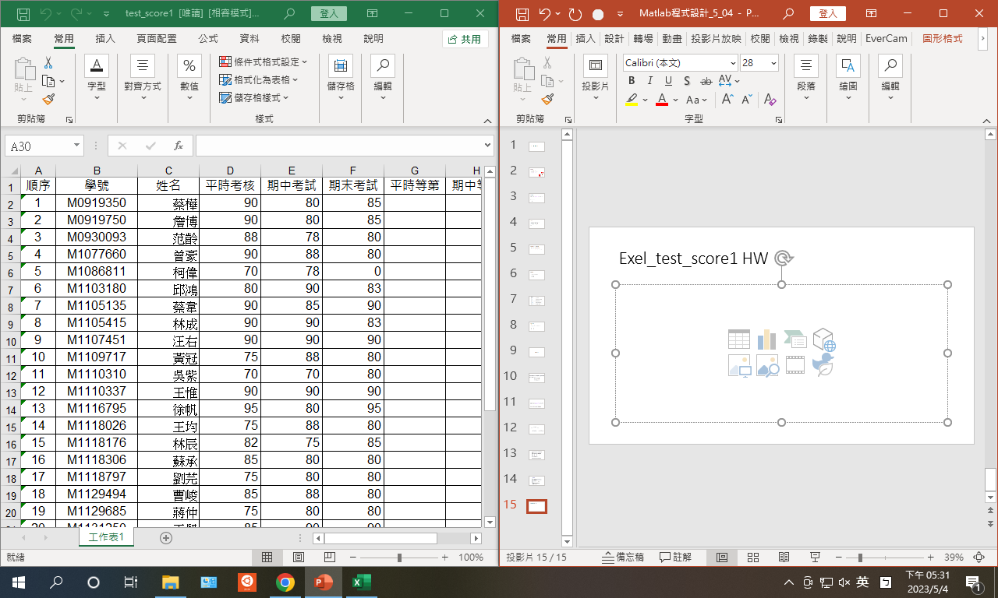
Excel_test_score1 HW
29 | Average score | - | Avg | Avg | Avg
Read Excel file with MATLAB in structure array
Calculate the average scores with mean function
Export table from MATLAB to edxcel

